Slide 1

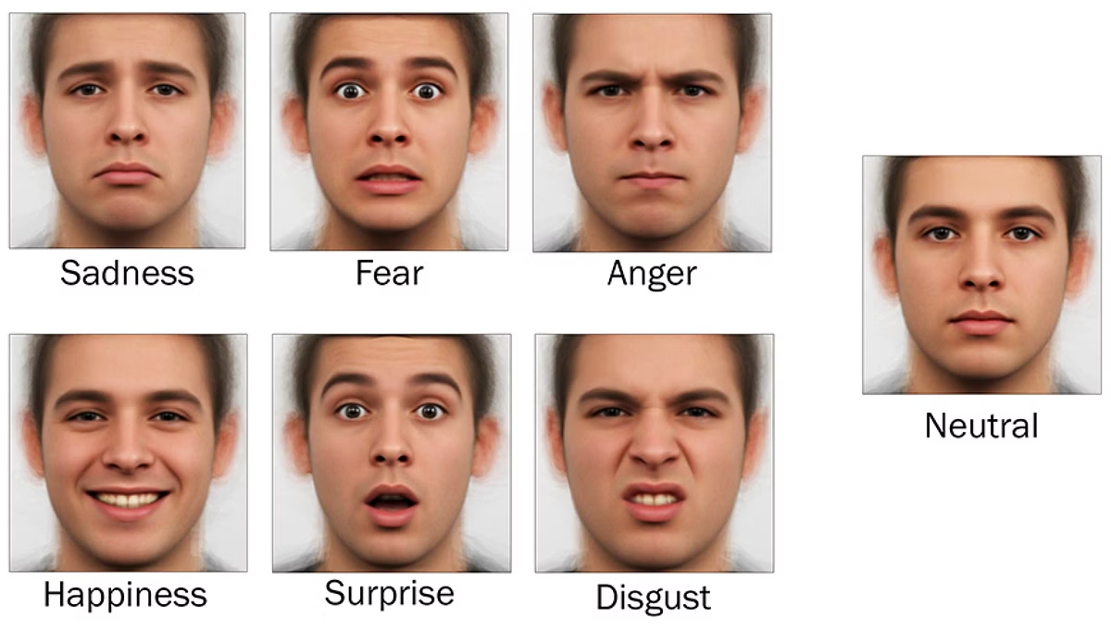
Multi-Modal Emotion Detection
This project explores multi-modal emotion detection. It combines facial expressions and vocal cues. The goal is to enhance emotion recognition accuracy. We aim to improve performance in real-world scenarios.

Slide 2

Project Team
This project was conducted by the following team members:
SHAIK MAHAMMED KAIF - N200460 : Team Lead
KAPALA CHAITANYA - N200629
B. SOMESH RAJU - N200991
CHANDURI BHAVANI SHANKAR - N200561
ALAMANDA VENKATA GANESH - N200050

Slide 3








Table of Contents
Abstract
Project overview and key outcomes.
Introduction
Motivation and real-world applications.
Related Works
Existing approaches and research gaps.
Methodology
Proposed methods.
Experimental Setup
Technologies/Libraries Used
Datasets
Final Outputs
Conclusion
Future Scope/Directions
References

Slide 4

Abstract
Multi-modal emotion detection leverages both facial expressions and vocal cues to enhance the accuracy of emotion recognition systems. This project explores the fusion of CNN-based facial emotion detection (using Haarcascades for face localization) and audio emotion recognition (using CNN-BiLSTM on spectral features). By combining these modalities through late fusion, the system achieves robust performance across diverse emotional states (angry, disgust, fear, happy, neutral, sad, surprise). The implementation utilizes datasets like FER2013 (face) and CREMA-D, TESS, SAVEE, RAVDES (audio), with real-time prediction capabilities. Key outcomes include improved detection accuracy and adaptability to real-world scenarios.

Slide 5
Introduction
Motivation
Real-World Applications
Human emotions are complex and often expressed through multiple channels (face, voice).
Healthcare: Mental health monitoring via patient interactions.
Single-modality systems (e.g., face-only) struggle with occlusions or noisy environments.
Customer Service: Sentiment analysis in call centers.
Education: Adaptive e-learning platforms that respond to student engagement.
Multi-modal approaches mitigate these limitations, offering higher reliability.

Slide 6
Related Works
1
Face-Only Models
CNNs on FER2013 (~60% accuracy). Fails with partial face visibility.
2
Audio-Only Models
LSTM-based systems on CREMA-D (~70% accuracy). Sensitive to background noise.
3
Early Fusion Models
Combined raw features. High computational cost.
4
Research Gaps Identified
Lack of efficient late-fusion techniques for real-time deployment.
Limited generalization across diverse demographics.

Slide 7





Proposed Methodology
Data Collection
Face: FER2013. Audio: CREMA-D, TESS, SAVEE, RAVDES.
Preprocessing
Face: Haarcascade detection. Audio: MFCC extraction.
Model Training
Face: CNN. Audio: CNN-BiLSTM.
Fusion
Late fusion (weighted averaging).

Slide 8
Experimental Setup
Technologies
Python, TensorFlow, OpenCV, Numpy, Pandas.
Datasets
Face: FER2013.
Audio: CREMA-D, TESS, SAVEE, REVDESS

Slide 9
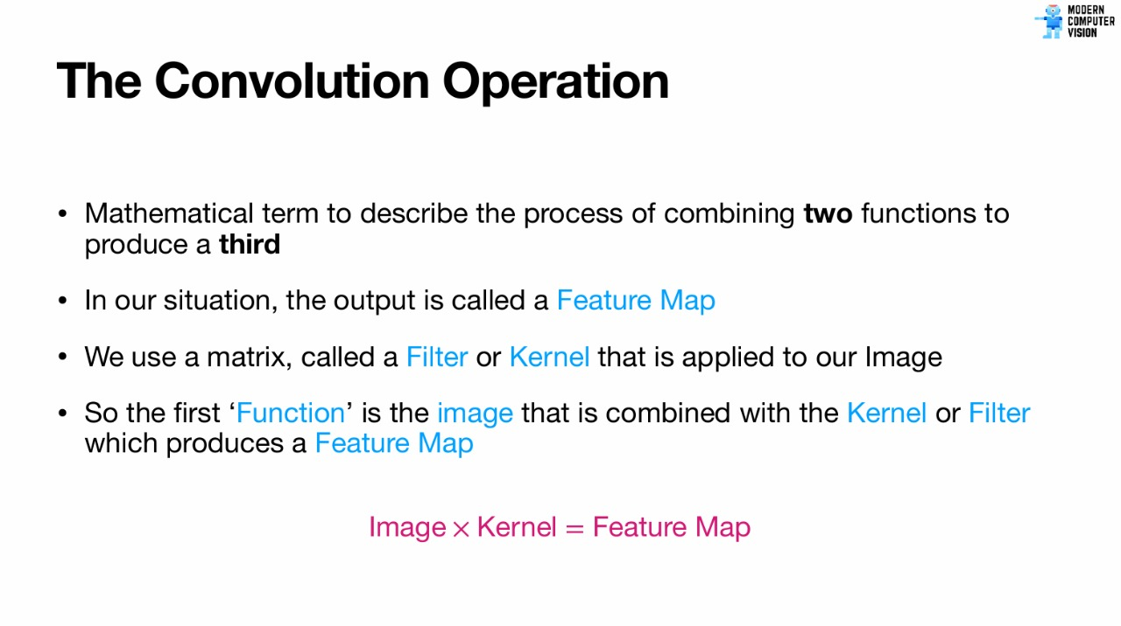

Slide 10
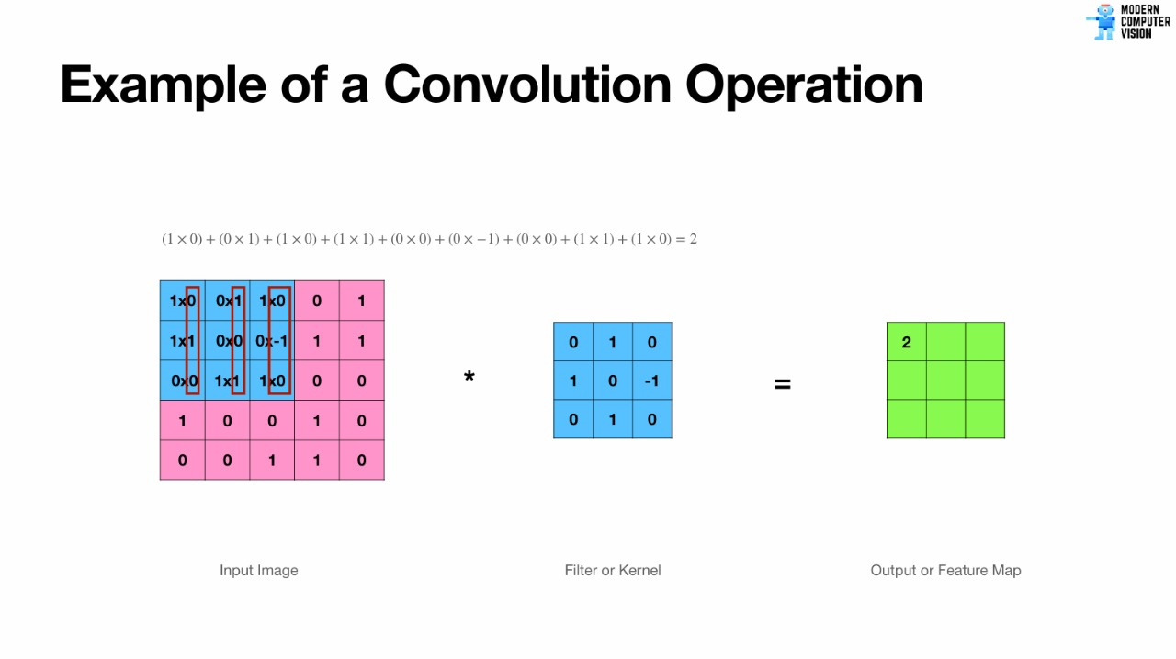

Slide 11
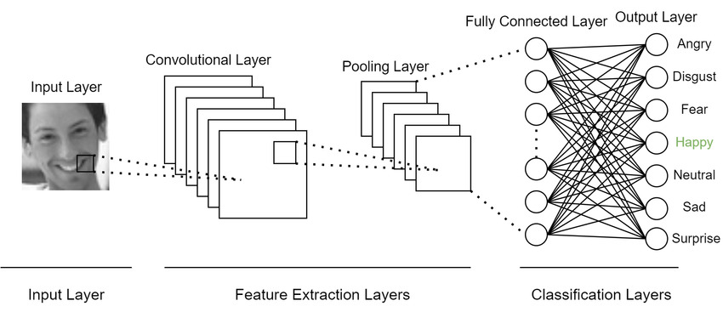
Facial Architecture

Slide 12
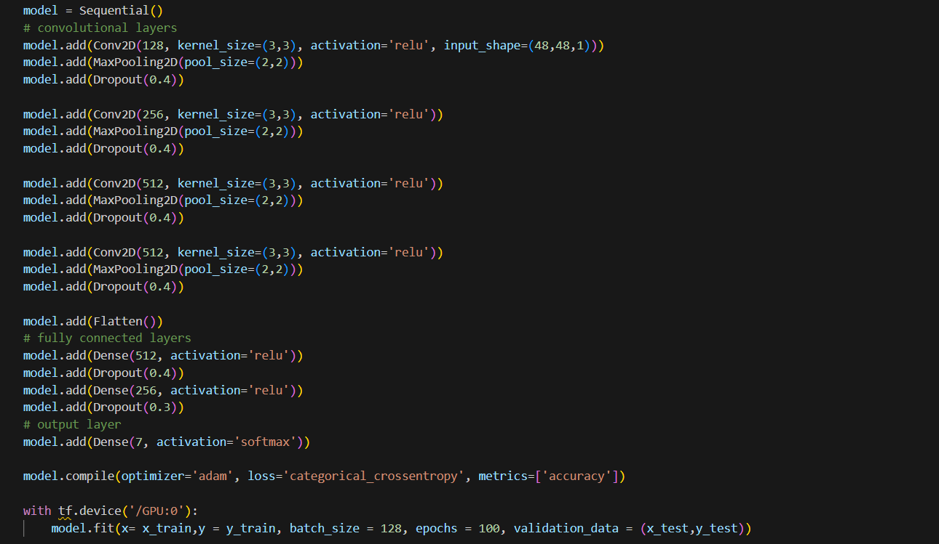
Facial Architecture Implementation

Slide 13
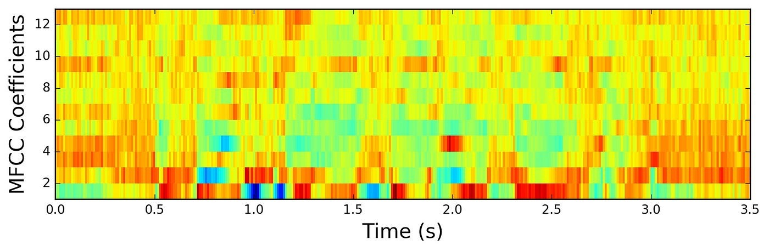
Audio Emotion Recognition
Augmentation : Data augmentation is the process of increasing the size and diversity of your dataset by applying transformations to existing data. This includes techniques like: -Adding noise -Time stretching (speeding up/slowing down) -Pitch shifting (raising/lowering tone)
What are MFCCS ?
MFCCs (Mel-Frequency Cepstral Coefficients) are numerical features that represent the shape and characteristics of the human voice and describe how the frequency content of the voice changes over time.

Slide 14
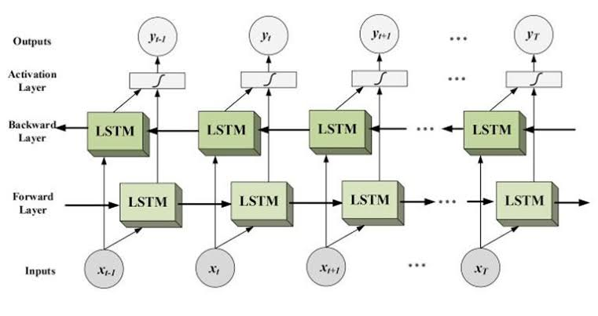
BiLSTM
How does a BiLSTM works?
A BiLSTM (Bidirectional Long Short-Term Memory) model processes sequences — like audio — by understanding both past and future context in the time series.

Slide 15
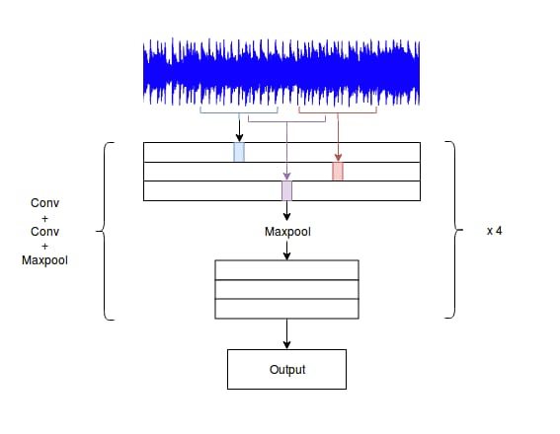
CNN
The 2D CNN in this code processes audio data reshaped as a time-frequency spectrogram (e.g., MFCCs or mel-spectrograms). It extracts local spatiotemporal patterns (like energy changes in frequency bands over short time windows)

Slide 16
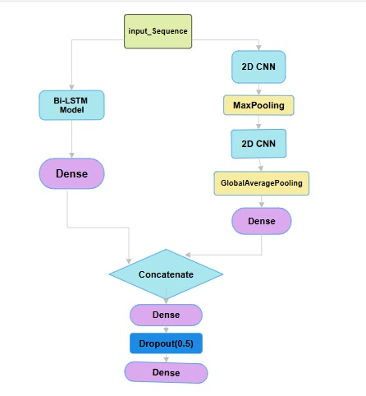
Voice Model Architecture
Architecture:
Branch 1 (BiLSTM): Processes sequential patterns using Bidirectional LSTM (256 total units) followed by dense layers.
Branch 2 (CNN): Treats input as a 2D grid (reshaped) to capture spatial/local features via convolutional/pooling layers.
Fusion: Combines outputs from both branches, adds dense layers, and produces class probabilities via softmax.

Slide 17
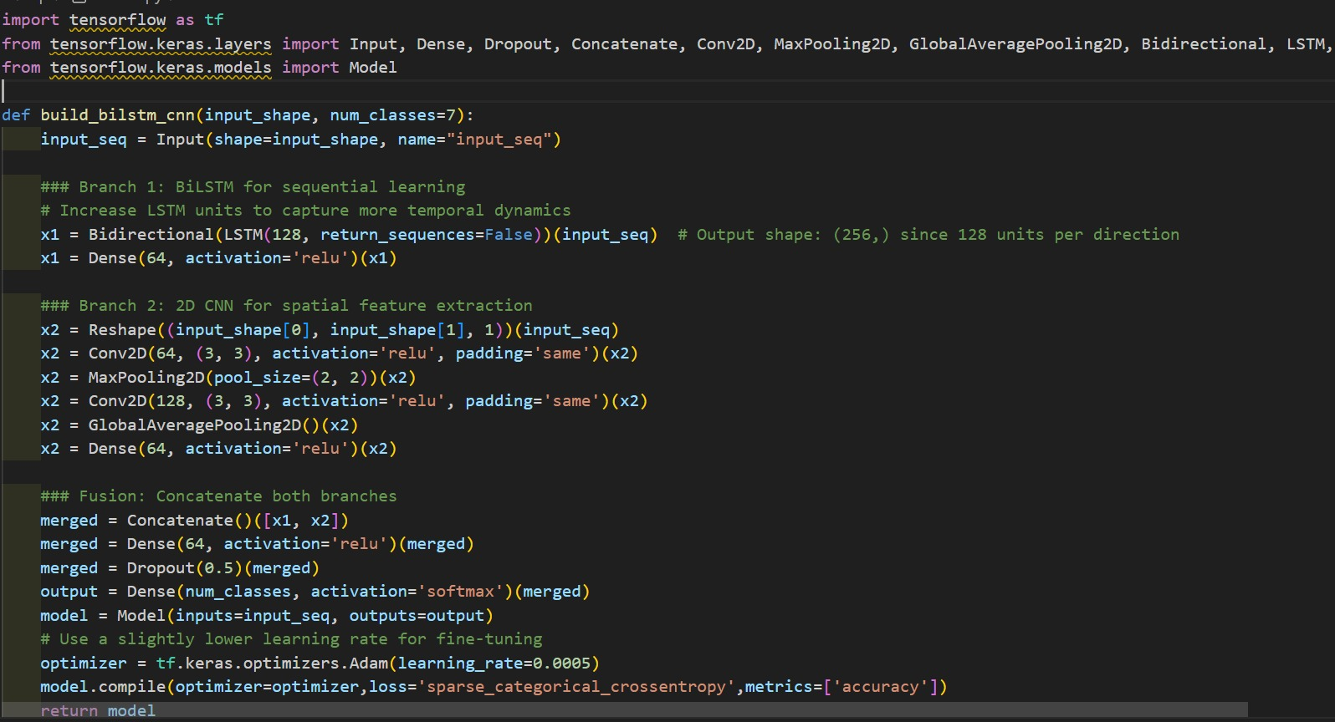
Voice Architecture Implementation

Slide 18
Late Fusion for Multimodal Emotion Recognition
What is Fusion ?
Combines facial (CNN) & audio (BiLSTM) predictions for 7 emotions: angry, disgust, fear, happy, neutral, sad, surprise.Overcomes single-modality issues (e.g., noise, ambiguity).
Fusion Technique: Late Fusion with Hybrid ApproachConfidence-Based Heuristic:Compares face & audio confidence scores.If one exceeds other by 20%, it dominates (e.g., face if face_conf > audio_conf + 0.2).
Neural Network Fusion: For close confidences, combines via: Concatenate (7+7=14 units) → Dense (32, ReLU) → Dropout (0.3) → Dense (7, softmax).Benefit: Up to 10% accuracy improvement.

Slide 19
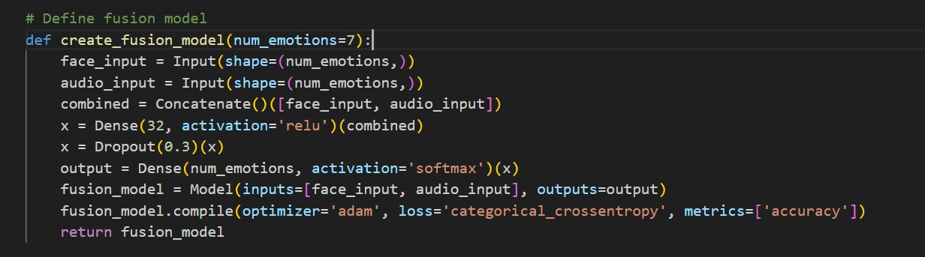
Fusion Model Architecture

Slide 20
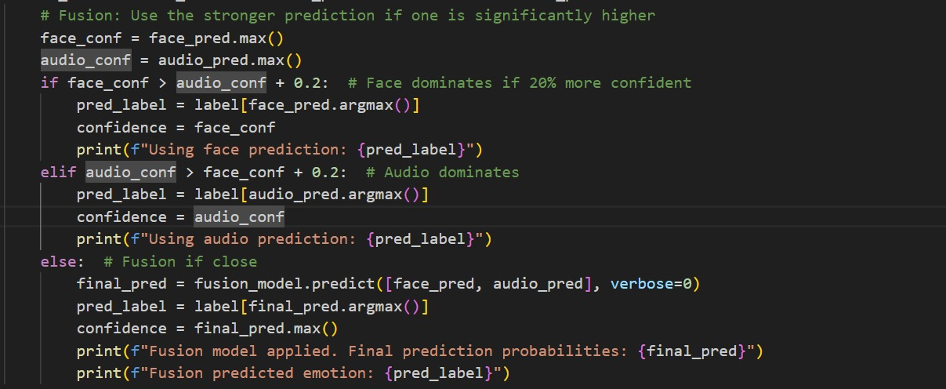
Fusion Decision Logic

Slide 21
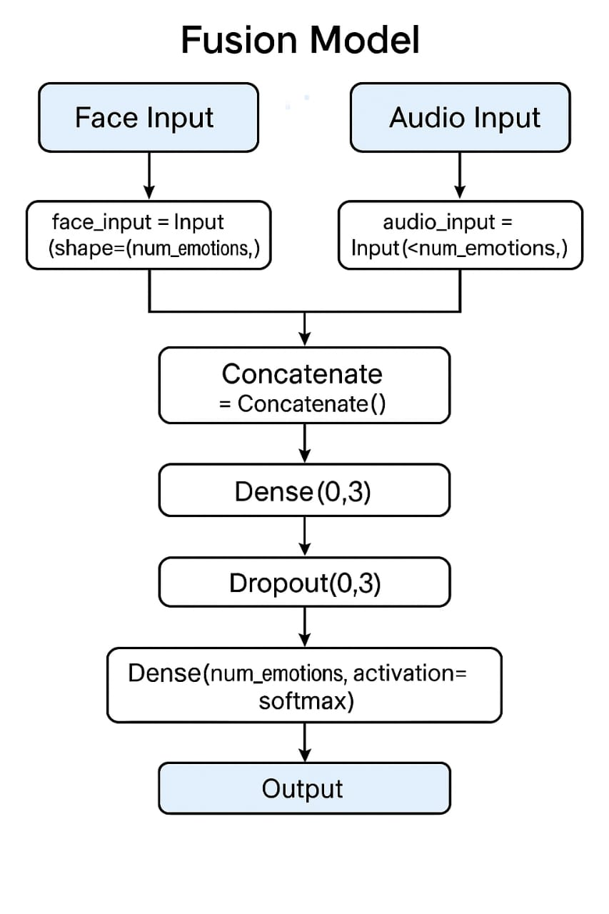

Slide 22
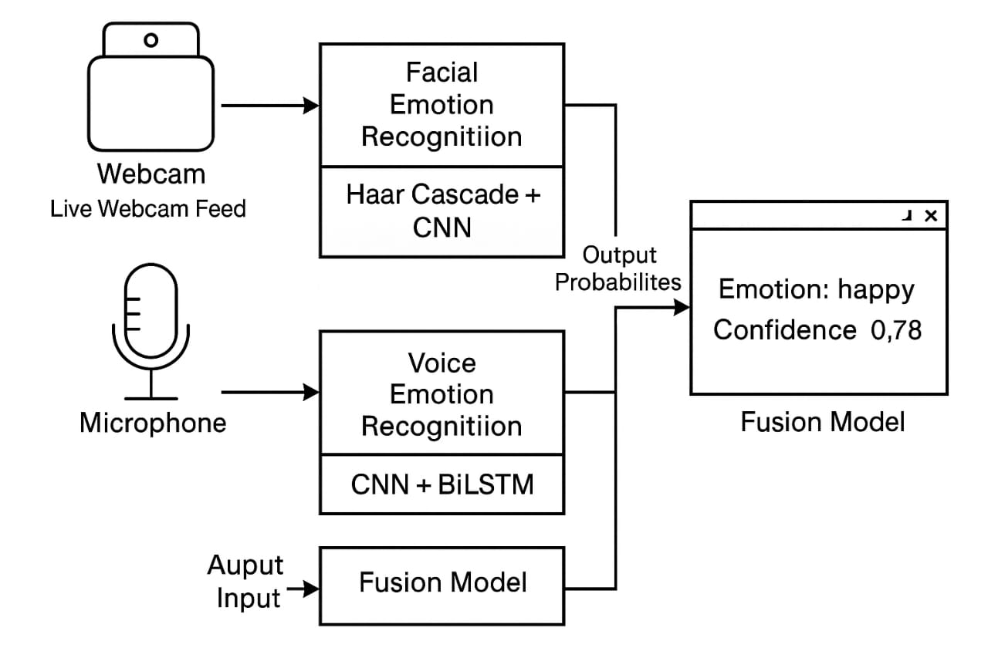
Overall View

Slide 23
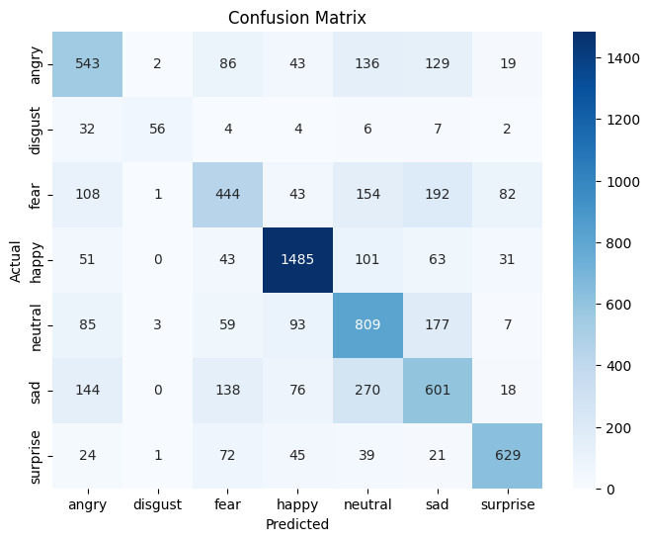
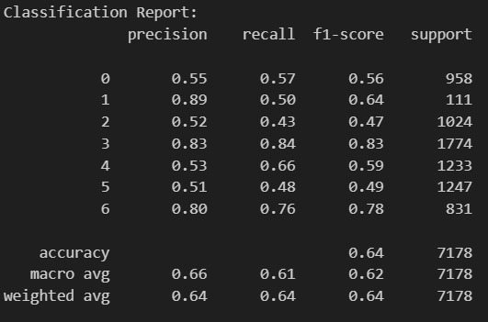
Confusion Matrix (Face Model):
Classification Report(Face Model):

Slide 24
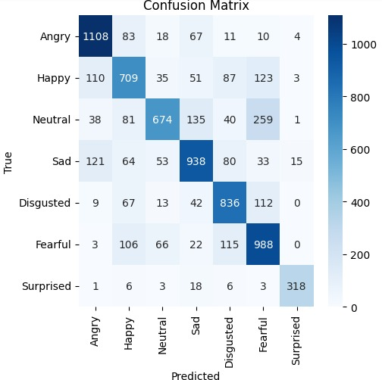
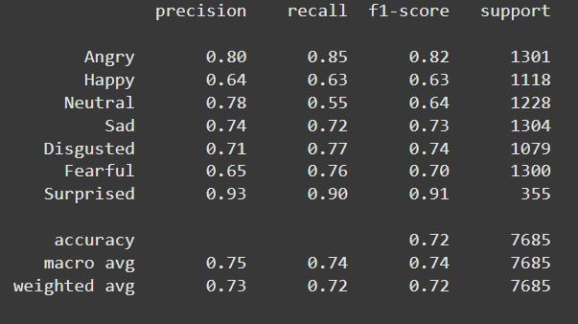
Confusion Matrix (Audio Model):
Classification Report(Audio Model):

Slide 25
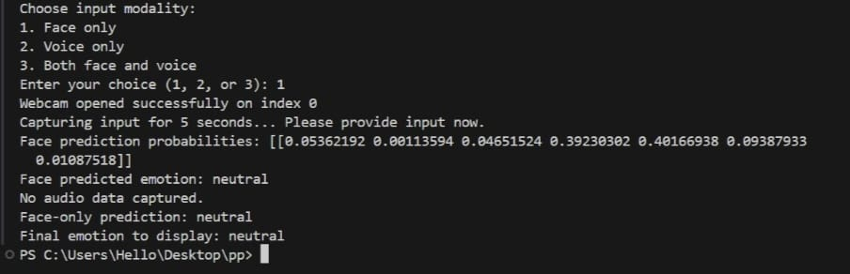
Output

Slide 26
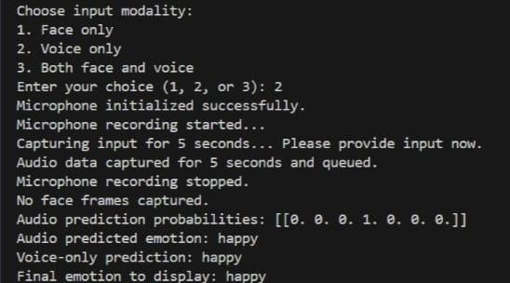
Output

Slide 27
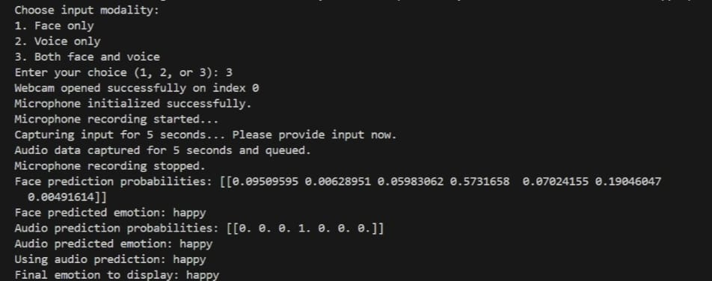
Output

Slide 28
Conclusion
Model Performance
Real-Time Feasibility
Challenges
Fusion model outperforms single-modality systems. Achieves 70% accuracy.
Implementation demonstrates feasibility for virtual assistants.
Latency in audio processing and bias in training datasets.

Slide 29

Future Scope
Hybrid Architectures
Combine transformers for audio with 3D CNNs.
Recommendations
Specialized recommendations such as places or songs based on emotion .
Explainability
Integrate SHAP values to interpret decisions.

Slide 30
References
Development of Convolutional Neural Network Models to Improve Facial Expression Recognition Accuracy
-ISSN: 2338-3070, DOI: 10.26555/jiteki.v10i2.28863
A BiLSTM–Transformer and 2D CNN Architecture for Emotion Recognition from Speech.
- Sera Kim 1 and Seok-Pil Lee

Slide 31
Gratitude and Appreciation
As we conclude our presentation on the Multi-Modal Emotion Detection project, we would like to express our heartfelt gratitude to all those who have contributed to its success. This has been a collaborative effort, and we are thankful for the support and insights provided by our project team, industry partners, and the research community.
The journey of bringing this innovative solution to life has been both challenging and rewarding. We are proud of the progress we have made and the impact this technology can have in real-world applications. None of this would have been possible without the dedication and hard work of everyone involved.
We appreciate your time and attention today, and we hope that our work has provided valuable insights and inspiration. Thank you for your interest and engagement. We look forward to continued collaboration and the opportunity to further advance the field of emotion detection and recognition.
Thank you for your time and attention. We welcome any questions or feedback you may have.

